Slide 1
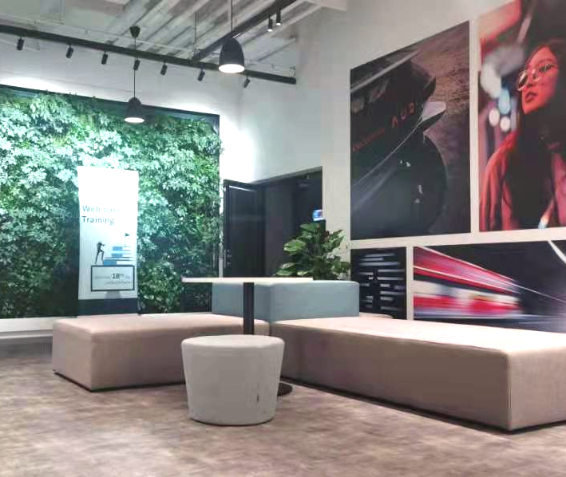
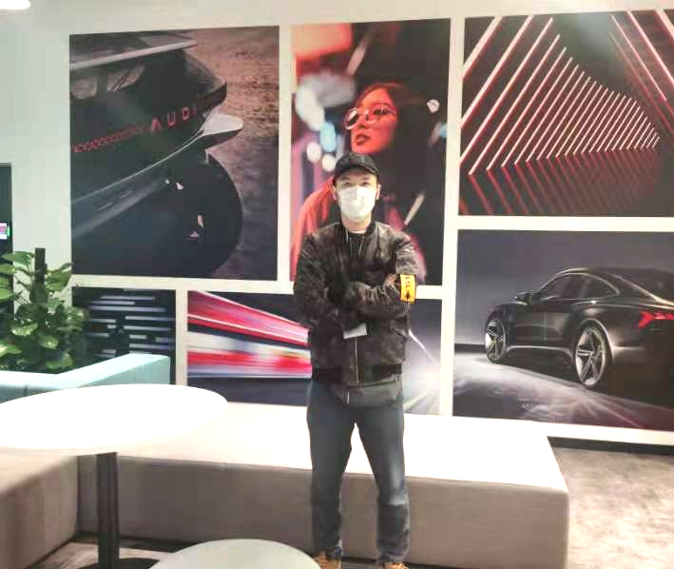
All new Audi A8L Horch EOS shooting plan for Mr. Eichhorn
Date: Oct.22nd
Time: 15:30-16:30
Location: Floor 6, out of the East 08 meeting room
Dress code: Dark blue or black suit with white shirt without tie, leather shoes
Shot description:
Set up 1
Track back on Audi logo, Mr. Eichhorn stands beside the table with Audi logo on it
Set up 2
Wide shot Eichhorn gives speech with a few small steps moving towards camera
Medium shot Eichhorn gives speech to camera
Others:
There is no need for a sofa in the scene, but a small table should be reserved to place the Audi logo, so the sofa needs to be moved to other areas before shooting.
Set up 1
Set up 2

